Slide 1
The Relational Model
Chapter 3

Slide 2
Why Study the Relational Model?
Most widely used model.
  Vendors: IBM, Informix, Microsoft, Oracle, Sybase, etc.
“Legacy systems” in older models
  E.G., IBM’s IMS
Recent competitor: object-oriented model
  ObjectStore, Versant, Ontos
  A synthesis emerging: object-relational model
    Informix Universal Server, UniSQL, O2, Oracle, DB2

Slide 3
Relational Database: Definitions
Relational database: a set of relations
Relation: made up of 2 parts:
  Instance : a table, with rows and columns.
  #Rows = cardinality, #fields = degree / arity.
  Schema : specifies name of relation, plus name and type of each column.
    E.g., Students(sid: string, name: string, login: string,
age: integer, cgpa: real).
Can think of a relation as a set of rows or tuples (i.e., all rows are distinct).

Slide 4
Example Instance of Students Relation
Cardinality = 3, degree = 5, all rows distinct
Do all columns in a relation instance have to
be distinct?
b1b2
sid | name | login | age | cgpa
53666 | Jones | jones@cs | 22 | 8.9
53688 | Smith | smith@etc | 22 | 8.8
53650 | Smith | smith@me | 24 | 7.8

Slide 5
Relational Query Languages
A major strength of the relational model: supports simple, powerful querying of data.
Queries can be written intuitively, and the DBMS is responsible for efficient evaluation.
  The key: precise semantics for relational queries.
  Allows the optimizer to extensively re-order operations, and still ensure that the answer does not change.

Slide 6
SQL Query Language
Developed by IBM (system R) in the 1970s
Need for a standard since it is used by many vendors
Standards:
  SQL-86
  SQL-89 (minor revision)
  SQL-92 (major revision)
  SQL-99 (major extensions, standard)
  ….and…

Slide 7
The SQL Query Language
To find all 22 year old students, we can write: link1
SELECT *
FROM Students S
WHERE S.age=22
To find just names and logins, replace the first line:
SELECT S.name, S.login
sid | name | login | age | cgpa
53666 | Jones | jones@cs | 22 | 8.9
53688 | Smith | smith@etc | 22 | 8.8

Slide 8
Querying Multiple Relations
What does the following query compute?
SELECT S.name, E.cid
FROM Students S, Enrolled E
WHERE S.sid=E.sid AND E.grade=“A” link2
Given the following instance
of Enrolled (is this possible if
the DBMS ensures referential
integrity?):
we get:
sid | cid | Grade
53831 53831 53650 53666 | CS101 CS102 CS103 CS104 | C B A B
S.name | E.cid
Smith | CS103

Slide 9
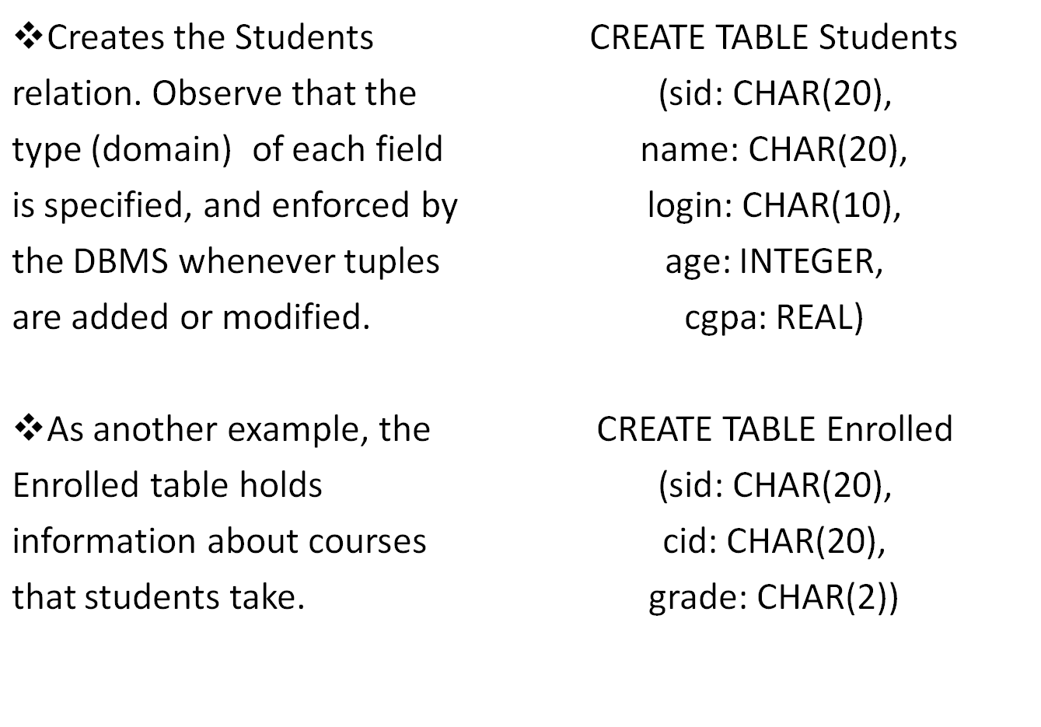
Creating Relations in SQL

Slide 10
Destroying and Altering Relations
DROP TABLE Students
Destroys the relation Students. The schema information and the tuples are deleted.
ALTER TABLE Students
ADD COLUMN firstYear: integer
The schema of Students is altered by adding a new field; every tuple in the current instance is extended with a null value in the new field.

Slide 11
Adding and Deleting Tuples
Can insert a single tuple using:
INSERT INTO Students (sid, name, login, age, cgpa)
VALUES (53688, ‘Smith’, ‘smith@etc’, 22, 8.8)
Can delete all tuples satisfying some condition (e.g., name = Smith):
DELETE
FROM Students S
WHERE S.name = ‘Smith’
Powerful variants of these commands are available; more later!

Slide 12
Integrity Constraints (ICs)
IC: condition that must be true for any instance of the database; e.g., domain constraints.
  ICs are specified when schema is defined.
  ICs are checked when relations are modified.
A legal instance of a relation is one that satisfies all specified ICs.
  DBMS should not allow illegal instances.
If the DBMS checks ICs, stored data is more faithful to real-world meaning.
  Avoids data entry errors, too!

Slide 13
Primary Key Constraints
A set of fields is a key for a relation if :
1. No two distinct tuples can have same values in all key fields, and
2. This is not true for any subset of the key.
  Part 2 false? A superkey.
  If there’s >1 key for a relation, one of the keys is chosen (by DBA) to be the primary key.
E.g., sid is a key for Students. (What about name?) The set {sid, cgpa} is a superkey.

Slide 14
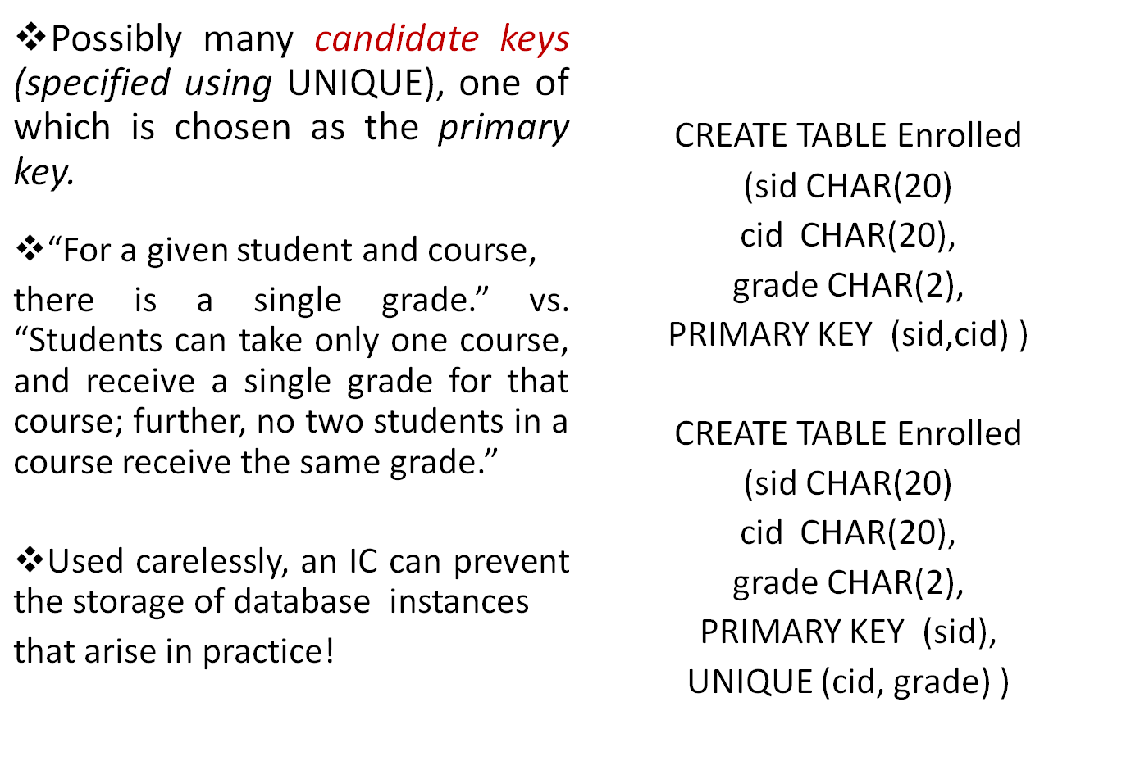
Primary and Candidate Keys in SQL

Slide 15
Foreign Keys, Referential Integrity
Foreign key : Set of fields in one relation that is used to `refer’ to a tuple in another relation. (Must correspond to primary key of the second relation.) Like a `logical pointer’.
E.g. sid is a foreign key referring to Students:
  Enrolled(sid: string, cid: string, grade: string)
  If all foreign key constraints are enforced, referential integrity is achieved, i.e., no dangling references.
  Can you name a data model w/o referential integrity?
    Links in HTML!

Slide 16
Foreign Keys in SQL
Only students listed in the Students relation should be allowed to enroll for courses.
CREATE TABLE Enrolled
(sid CHAR(20), cid CHAR(20), grade CHAR(2), PRIMARY KEY (sid,cid), FOREIGN KEY (sid) REFERENCES Students )
Students
Enrolled
sid | name | login | age | cgpa
53666 | Jones | jones@cs | 22 | 8.9
53688 | Smith | smith@etc | 22 | 8.8
53650 | Smith | smith@me | 24 | 7.8
sid | cid | Grade
53831 53831 53650 53666 | CS101 CS102 CS103 CS104 | C B A B

Slide 17
Enforcing Referential Integrity
Consider Students and Enrolled; sid in Enrolled is a foreign key that references Students.
What should be done if an Enrolled tuple with a non-existent student id is inserted? (Reject it!)
What should be done if a Students tuple is deleted?
  Also delete all Enrolled tuples that refer to it.
  Disallow deletion of a Students tuple that is referred to.
  Set sid in Enrolled tuples that refer to it to a default sid.
  (In SQL, also: Set sid in Enrolled tuples that refer to it to a
  special value null, denoting `unknown’ or `inapplicable’.)
Similar if primary key of Students tuple is updated.

Slide 18
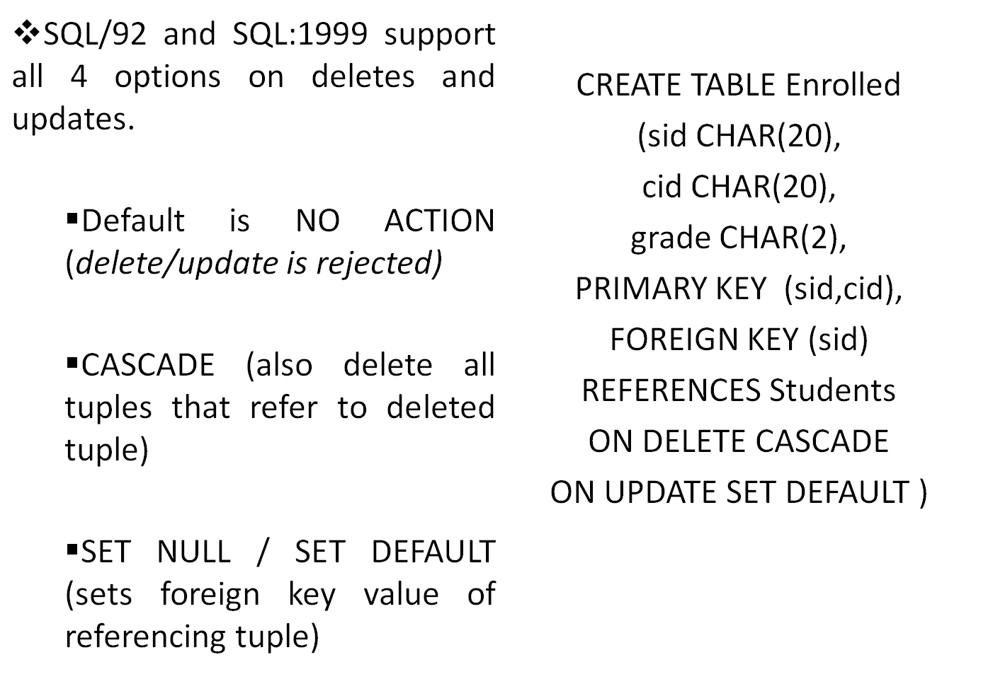
Referential Integrity in SQL

Slide 19
Where do ICs Come From?
ICs are based upon the semantics of the realworld enterprise that is being described in the database relations.
We can check a database instance to see if an IC is violated, but we can NEVER infer that an IC is true by looking at an instance.
  An IC is a statement about all possible instances!
  From example, we know name is not a key, but the assertion that sid is a key is given to us.
Key and foreign key ICs are the most common; more general ICs supported too.

Slide 20
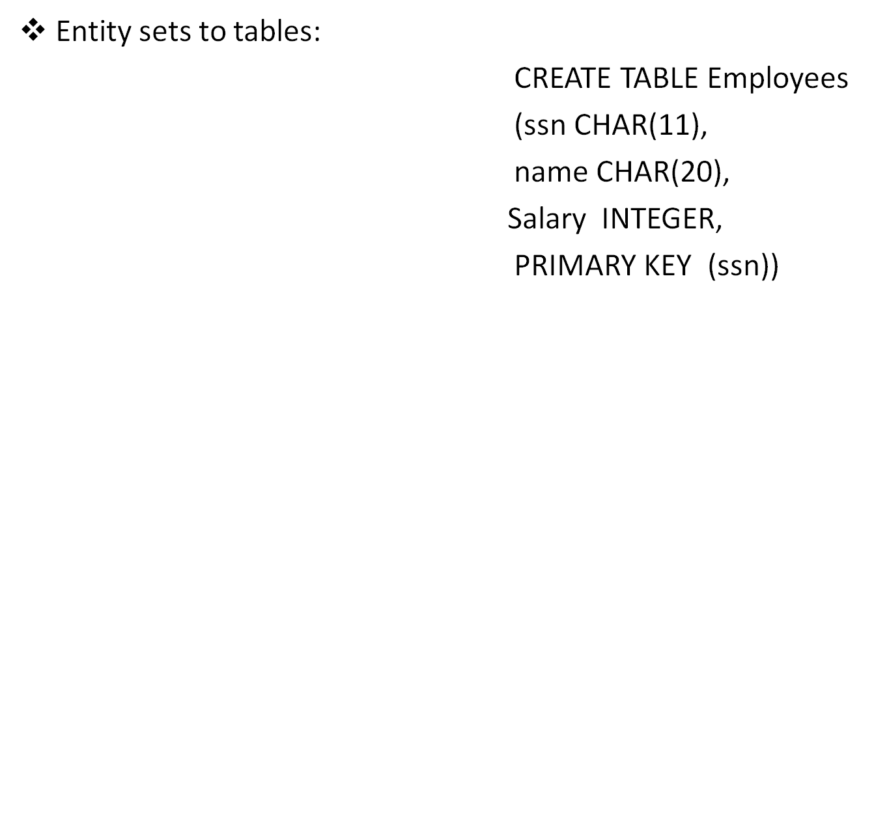
Logical DB Design: ER to Relational
ssn
name
salary
Employees

Slide 21
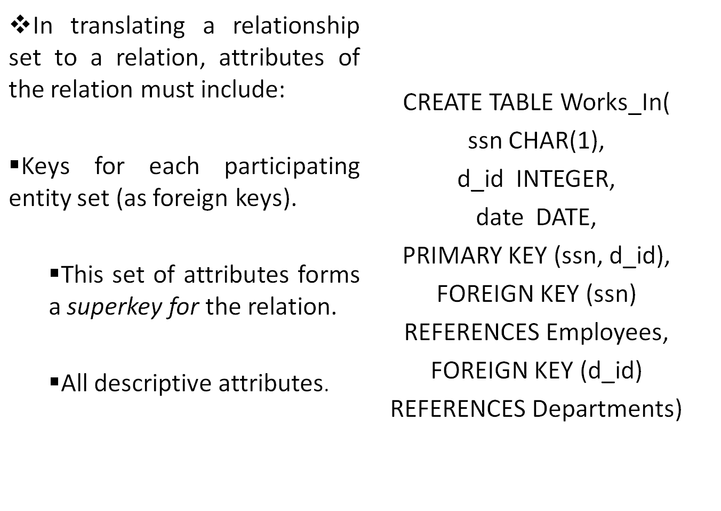
Relationship Sets to Tables

Slide 22
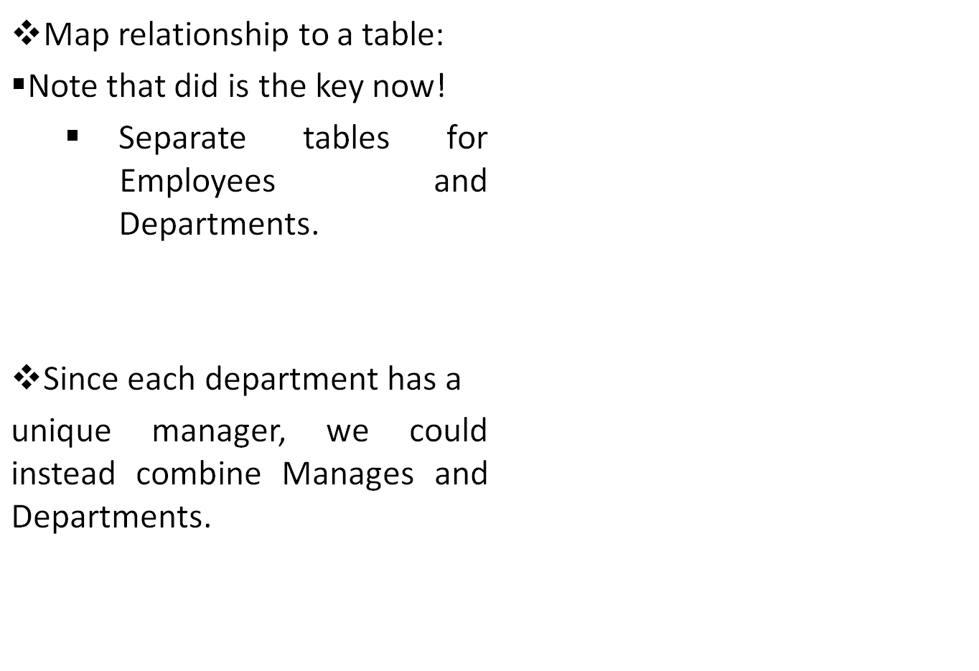
Translating ER Diagrams with Key Constraints
CREATE TABLE Manages(
ssn CHAR(11),
d_id INTEGER,
date DATE,
PRIMARY KEY ( d_id),
FOREIGN KEY (ssn)
REFERENCES Employees,
FOREIGN KEY (d_id)
REFERENCES Departments)
CREATE TABLE Dept_Mgn(
d_id INTEGER,
dname CHAR(20),
budget REAL,
ssn CHAR(11),
date DATE,
PRIMARY KEY ( d_id),
FOREIGN KEY (ssn)
REFERENCES Employees)

Slide 23
Participation Constraints
Does every department have a manager?
If so, this is a participation constraint: the participation of
Departments in Manages is said to be total (vs. partial).
•Every d_id value in Departments table must appear in a
row of the Manages table (with a non-null ssn value!)
Manages
Employees
Departments
Works _in

Slide 24
Participation Constraints in SQL
We can capture participation constraints involving one entity set in a binary relationship, but little else (without resorting to CHECK constraints).
CREATE TABLE Dept_Mgr(
d_id INTEGER,
d_name CHAR(20),
budget REAL,
ssn CHAR(11) NOT NULL,
date DATE,
PRIMARY KEY ( d_id),
FOREIGN KEY (ssn) REFERENCES Employees,
ON DELETE NO ACTION)

Slide 25
Weak Entities
A weak entity can be identified uniquely only by considering the primary key of another (owner) entity.
  Owner entity set and weak entity set must participate in a
  one-to-many relationship set (1 owner, many weak entities).
  Weak entity set must have total participation in this
  identifying relationship set.
cost
Policy
Departments
Employees

Slide 26
Translating Weak Entity Sets
Weak entity set and identifying relationship set are translated into a single table.
  When the owner entity is deleted, all owned weak entities must also be deleted.
CREATE TABLE Dep_Policy(
pname CHAR(20),
age INTEGER,
cost REAL,
ssn CHAR(11) NOT NULL,
PRIMARY KEY ( pname, ssn),
FOREIGN KEY (ssn) REFERENCES Employees,
ON DELETE CASCADE)

Slide 27
Translating ISA Hierarchies to Relations
General approach:
  3 relations: Employees, Hourly and Contract.
  Hourly: Every employee is recorded in Employees. For hourly , extra info recorded in Hourly (hourly_wages, hours_worked, ssn); must delete Hourly tuple if referenced Employees tuple is deleted).
  Queries involving all employees easy, those involving just Hourly require a join to get some attributes.
Alternative: Just Hourly and Contract.
  Hourly: ssn, name, lot, hourly_wages, hours_worked.
  Each employee must be in one of these two subclasses.

Slide 28
Views
A view is just a relation, but we store a definition, rather than a set of tuples.
  CREATE VIEW YoungActiveStudents (name, grade)
  AS SELECT S.name, E.grade
  FROM Students S, Enrolled E
  WHERE S.sid = E.sid and S.age<21
Views can be dropped using the DROP VIEW command.
  How to handle DROP TABLE if there’s a view on the table?
  DROP TABLE command has options to let the user specify
  this.

Slide 29
Views and Security
Views can be used to present necessary information (or a summary), while hiding details in underlying relation(s).
  Given YoungActiveStudents, but not Students or Enrolled, we can find students s who have are enrolled, but not the cid’s of the courses they are enrolled in.

Slide 30
Relational Model: Summary
A tabular representation of data.
Simple and intuitive, currently the most widely used.
Integrity constraints can be specified by the DBA, based on application semantics. DBMS checks for violations.
  Two important ICs: primary and foreign keys
  In addition, we always have domain constraints.
Powerful and natural query languages exist.
Rules to translate ER to relational model

